Slide 1
Learning how to pool features Vector of Locally Aggregated Descriptors (VLAD)
Silvio Giancola
Thursday, October 12th 2017

Slide 2
Outline
Aggregating local descriptors into a compact image representation, Hervé Jégou, Matthijs Douze, Cordelia Schmid, and Patrick Pérez [CVPR10]
All about VLAD, Relja Arandjelovic, and Andrew Zisserman. [CVPR13]
NetVLAD: CNN architecture for weakly supervised place recognition, Relja Arandjelovic, Petr Gronat, Akihiko Torii, Tomas Pajdla, Josef Sivic [CVPR16]
ActionVLAD: Learning spatio-temporal aggregation for action classification, Rohit Girdhar, Deva Ramanan, Abhinav Gupta, Josef Sivic , Bryan Russell [CVPR17]
Learnable pooling with Context Gating for video classification. Antoine Miech, Ivan Laptev et Josef Sivic [YT8M17]

Slide 3
Outline
Aggregating local descriptors into a compact image representation, Hervé Jégou, Matthijs Douze, Cordelia Schmid, and Patrick Pérez [CVPR10]
All about VLAD, Relja Arandjelovic, and Andrew Zisserman. [CVPR13]
NetVLAD: CNN architecture for weakly supervised place recognition, Relja Arandjelovic, Petr Gronat, Akihiko Torii, Tomas Pajdla, Josef Sivic [CVPR16]
ActionVLAD: Learning spatio-temporal aggregation for action classification, Rohit Girdhar, Deva Ramanan, Abhinav Gupta, Josef Sivic , Bryan Russell [CVPR17]
Learnable pooling with Context Gating for video classification. Antoine Miech, Ivan Laptev et Josef Sivic [YT8M17]

Slide 4
VLAD - Vector of Locally Aggregated Descriptors
Content-Based Image retrieval on a very large scale (>10M image):
Accuracy of the search: finding coherent images (mAP)
Efficiency of the search: reducing computation complexity
Memory usage of the representation: limiting storage
Content-Based Image Retrieval
Image Dataset
Jégou, Hervé, et al. "Aggregating local descriptors into a compact image representation." Computer Vision and Pattern Recognition (CVPR), 2010 IEEE Conference on. IEEE, 2010

Slide 5
VLAD - Vector of Locally Aggregated Descriptors
What is VLAD?
Aggregation of local image descriptors (SIFT,…)
Fits a 20-byte representation
Takes about 50ms to search a 10M image dataset
Compete with state-of-the-art aggregation techniques:
Bag-of-Features (BOF) / Bag-of-Word (BOW)
Fischer Vectors (FV)
Jégou, Hervé, et al. "Aggregating local descriptors into a compact image representation." Computer Vision and Pattern Recognition (CVPR), 2010 IEEE Conference on. IEEE, 2010

Slide 6
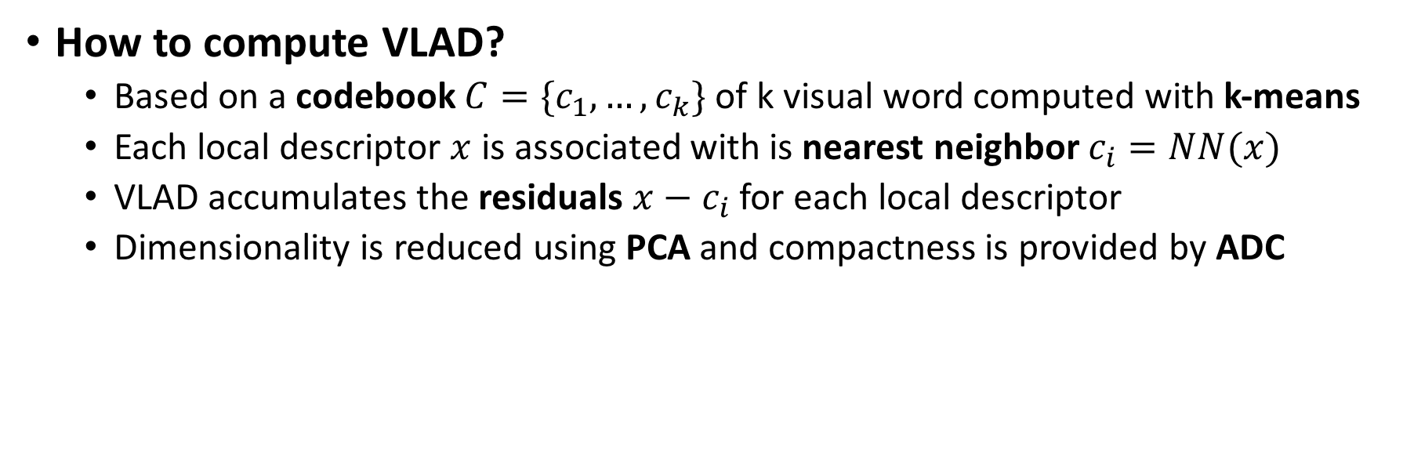
VLAD - Vector of Locally Aggregated Descriptors
How to compute VLAD?
Based on a codebook $C=\{c_{1}, …, c_{k}\}$ of k visual word computed with k-means
Each local descriptor $x$ is associated with is nearest neighbor $c_{i}=NN(x)$
VLAD accumulates the residuals $x−c_{i}$ for each local descriptor
Dimensionality is reduced using PCA and compactness is provided by ADC
Descriptors SIFT
Clustering (K-means)
Residuals
Dimensionality Reduction (PCA)
Asymmetric Distance Computation (ADC)
Jégou, Hervé, et al. "Aggregating local descriptors into a compact image representation." Computer Vision and Pattern Recognition (CVPR), 2010 IEEE Conference on. IEEE, 2010

Slide 7
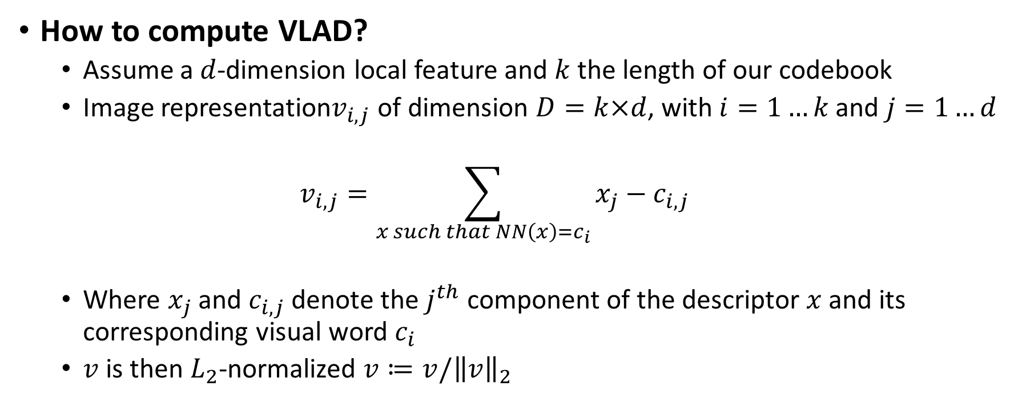
VLAD - Vector of Locally Aggregated Descriptors
How to compute VLAD?
Assume a $d$-dimension local feature and $k$ the length of our codebook
Image representation$v_{i,j}$ of dimension $D=k×d$, with $i=1…k$ and $j=1…d$
$$v_{i,j}=\sum_{x such that NN\left(x\right)=c_{i}}{x_{j}−c_{i,j}}$$
Where $x_{j}$ and $c_{i,j}$ denote the $j^{th}$ component of the descriptor $x$ and its corresponding visual word $c_{i}$
$v$ is then $L_{2}$-normalized $v≔v/{\left\|v\right\|}_{2}$
Jégou, Hervé, et al. "Aggregating local descriptors into a compact image representation." Computer Vision and Pattern Recognition (CVPR), 2010 IEEE Conference on. IEEE, 2010

Slide 8
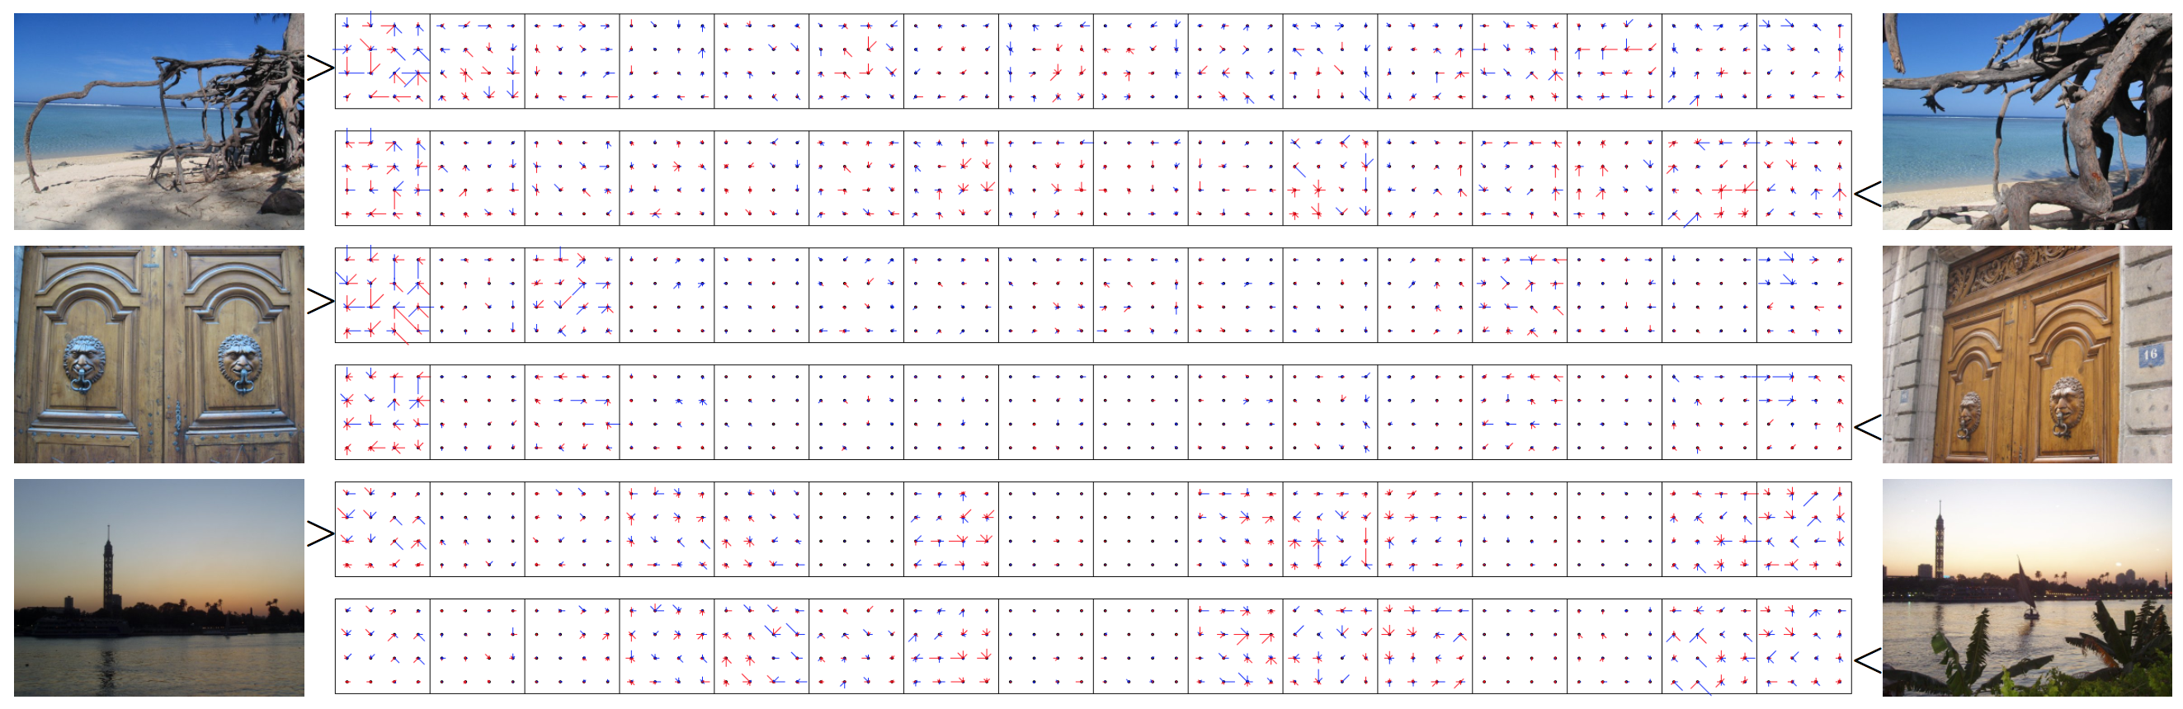
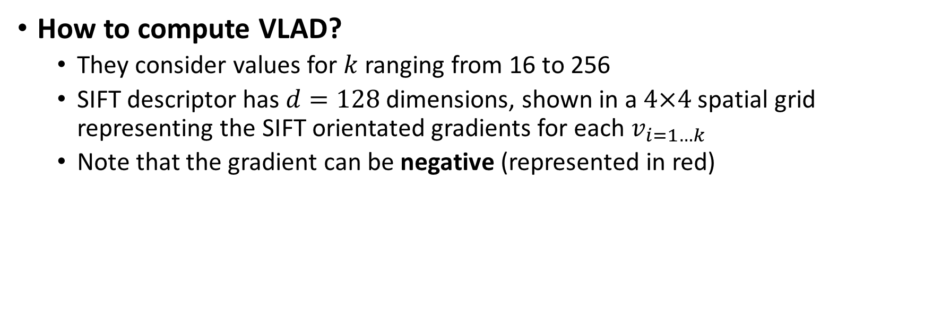
VLAD - Vector of Locally Aggregated Descriptors
How to compute VLAD?
They consider values for $k$ ranging from 16 to 256
SIFT descriptor has $d=128$ dimensions, shown in a $4×4$ spatial grid representing the SIFT orientated gradients for each $v_{i=1…k}$
Note that the gradient can be negative (represented in red)
Jégou, Hervé, et al. "Aggregating local descriptors into a compact image representation." Computer Vision and Pattern Recognition (CVPR), 2010 IEEE Conference on. IEEE, 2010

Slide 9
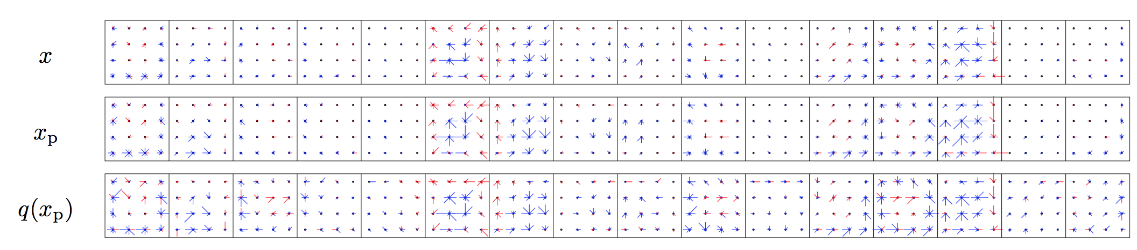
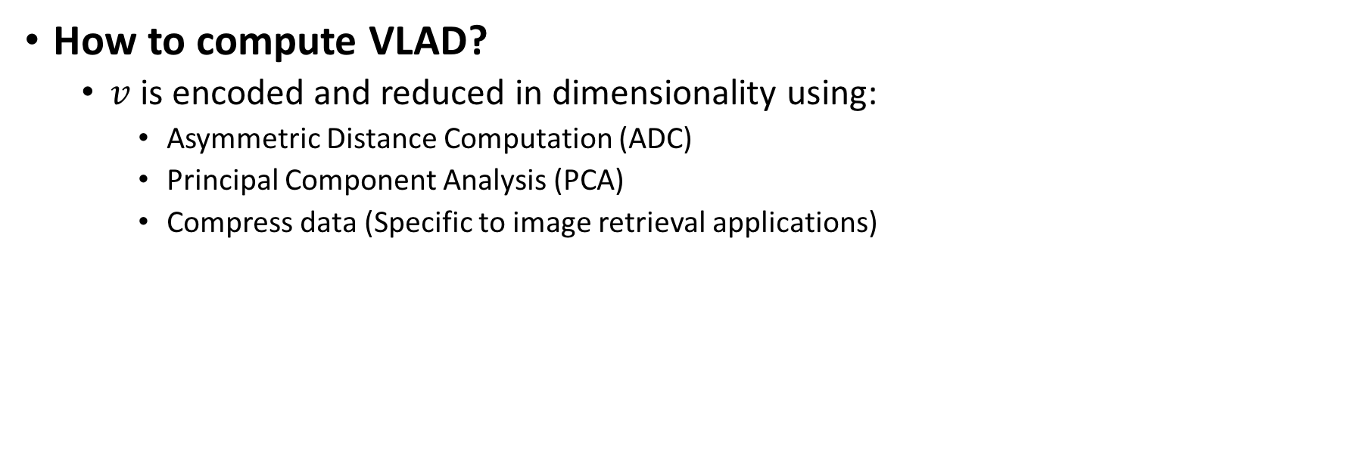
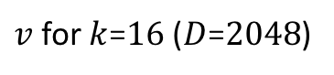
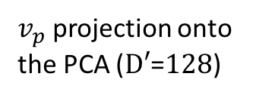
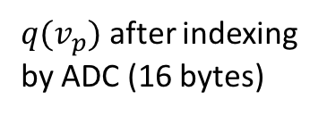
VLAD - Vector of Locally Aggregated Descriptors
How to compute VLAD?
$v$ is encoded and reduced in dimensionality using:
Asymmetric Distance Computation (ADC)
Principal Component Analysis (PCA)
Compress data (Specific to image retrieval applications)
$v$ for $k$=$16$ ($D$=$2048$)
$v_{p}$ projection onto the PCA ($D′$=$128$)
$q(v_{p})$ after indexing by ADC (16 bytes)
Jégou, Hervé, et al. "Aggregating local descriptors into a compact image representation." Computer Vision and Pattern Recognition (CVPR), 2010 IEEE Conference on. IEEE, 2010

Slide 10
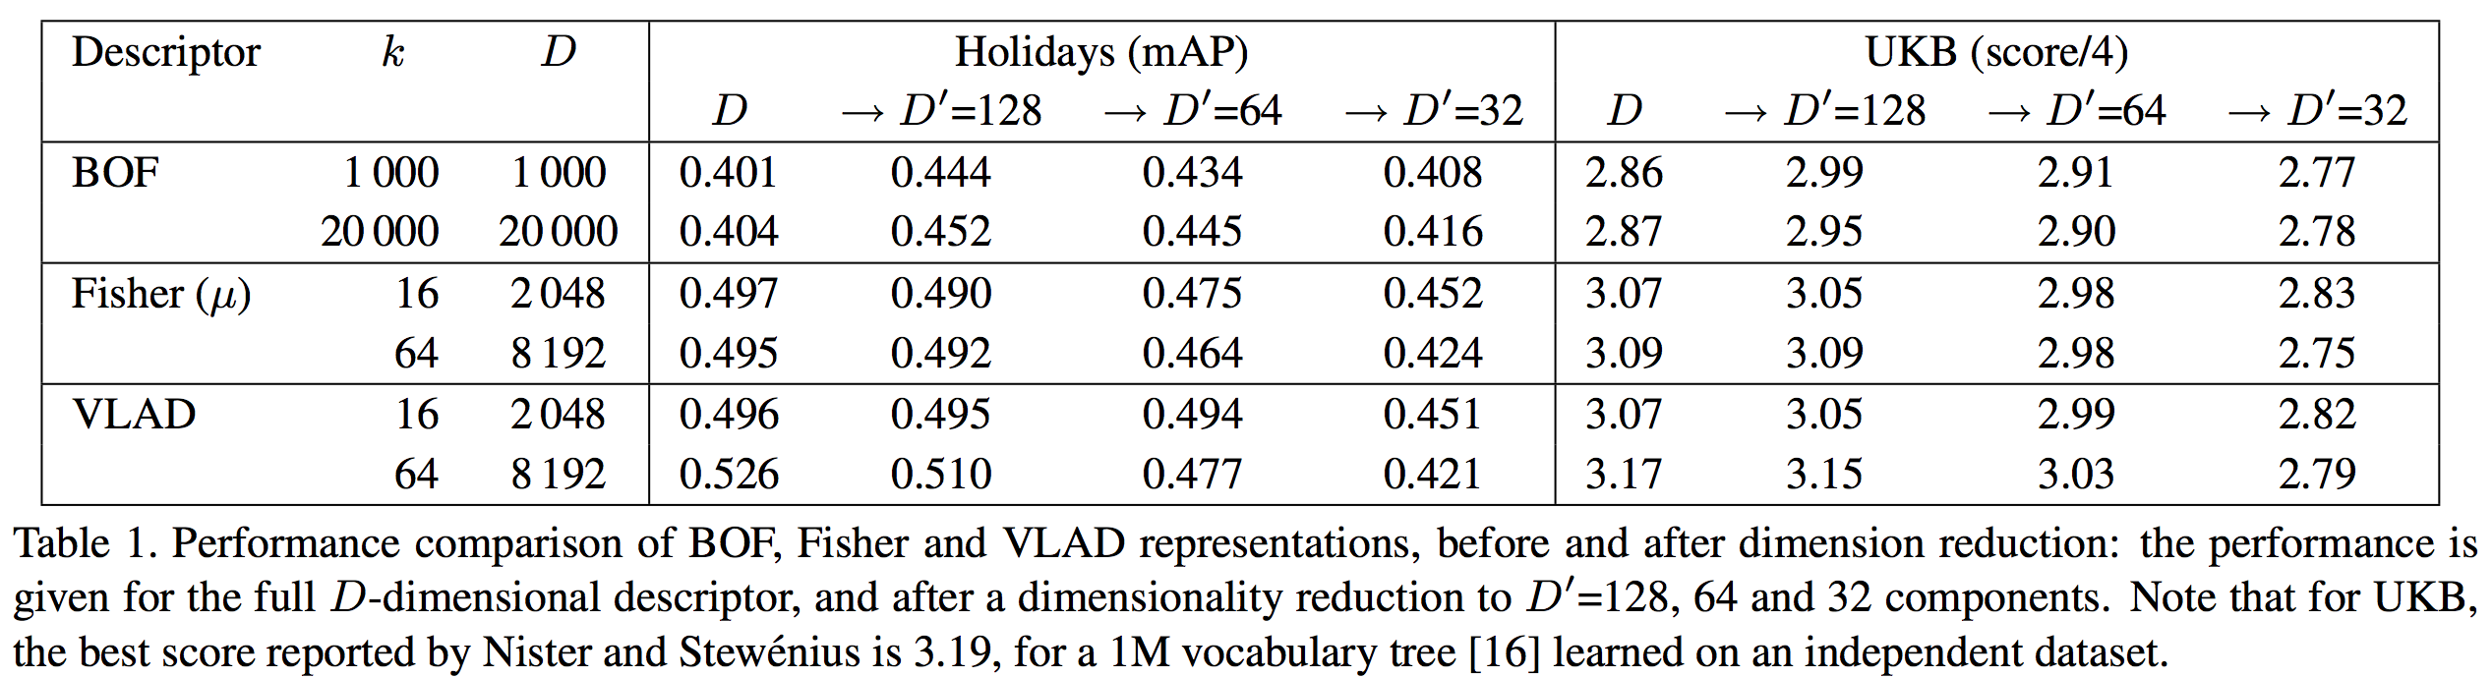
VLAD - Vector of Locally Aggregated Descriptors
How performant is VLAD?
Jégou, Hervé, et al. "Aggregating local descriptors into a compact image representation." Computer Vision and Pattern Recognition (CVPR), 2010 IEEE Conference on. IEEE, 2010

Slide 11
Outline
Aggregating local descriptors into a compact image representation, Hervé Jégou, Matthijs Douze, Cordelia Schmid, and Patrick Pérez [CVPR10]
All about VLAD, Relja Arandjelovic, and Andrew Zisserman. [CVPR13]
NetVLAD: CNN architecture for weakly supervised place recognition, Relja Arandjelovic, Petr Gronat, Akihiko Torii, Tomas Pajdla, Josef Sivic [CVPR16]
ActionVLAD: Learning spatio-temporal aggregation for action classification, Rohit Girdhar, Deva Ramanan, Abhinav Gupta, Josef Sivic , Bryan Russell [CVPR17]
Learnable pooling with Context Gating for video classification. Antoine Miech, Ivan Laptev et Josef Sivic [YT8M17]

Slide 12
All about VLAD
Three contributions to improve VLAD:
Vocabulary Adaptation
Intra-normalization
Multi-VLAD
Arandjelovic, Relja, and Andrew Zisserman. "All about VLAD." Proceedings of the IEEE conference on Computer Vision and Pattern Recognition. 2013

Slide 13
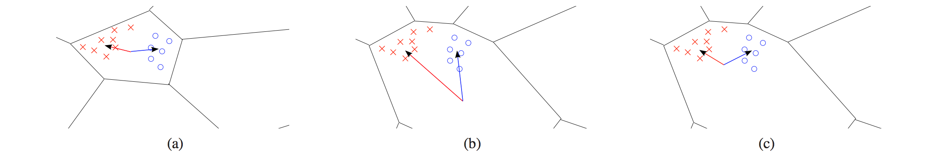
All about VLAD
Vocabulary Adaptation
K-mean clustering is dependent of the dataset used to compute the cluster centers
The Voronoi cells illustrate the coarse clustering used to construct VLAD
Red crosses (x),blue circle (o) corresponds to local descriptors from 2 images
Red (->) and blue (->) arrows represent the sum of residuals (difference between with the cluster)
Arandjelovic, Relja, and Andrew Zisserman. "All about VLAD." Proceedings of the IEEE conference on Computer Vision and Pattern Recognition. 2013

Slide 14
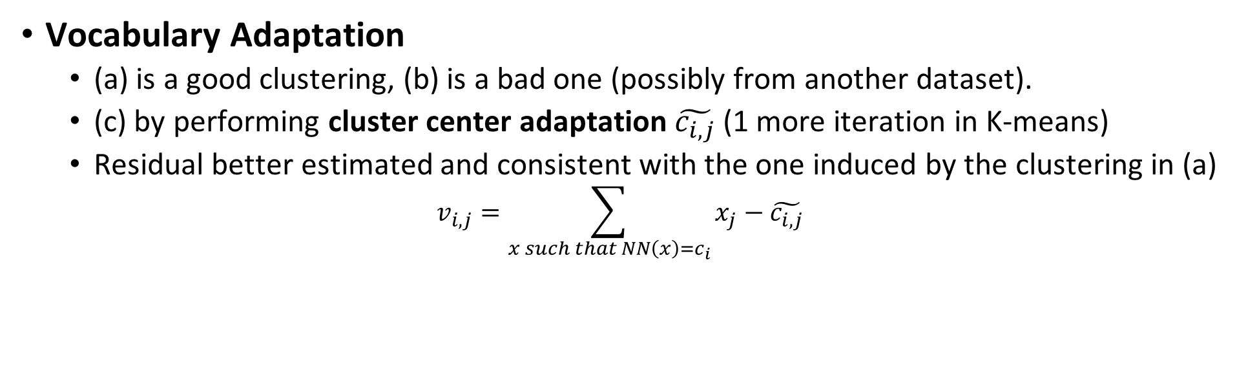
All about VLAD
Vocabulary Adaptation
(a) is a good clustering, (b) is a bad one (possibly from another dataset).
(c) by performing cluster center adaptation $\tilde{c_{i,j}}$ (1 more iteration in K-means)
Residual better estimated and consistent with the one induced by the clustering in (a)
$$v_{i,j}=\sum_{x such that NN\left(x\right)=c_{i}}{x_{j}−\tilde{c_{i,j}}}$$
Arandjelovic, Relja, and Andrew Zisserman. "All about VLAD." Proceedings of the IEEE conference on Computer Vision and Pattern Recognition. 2013

Slide 15
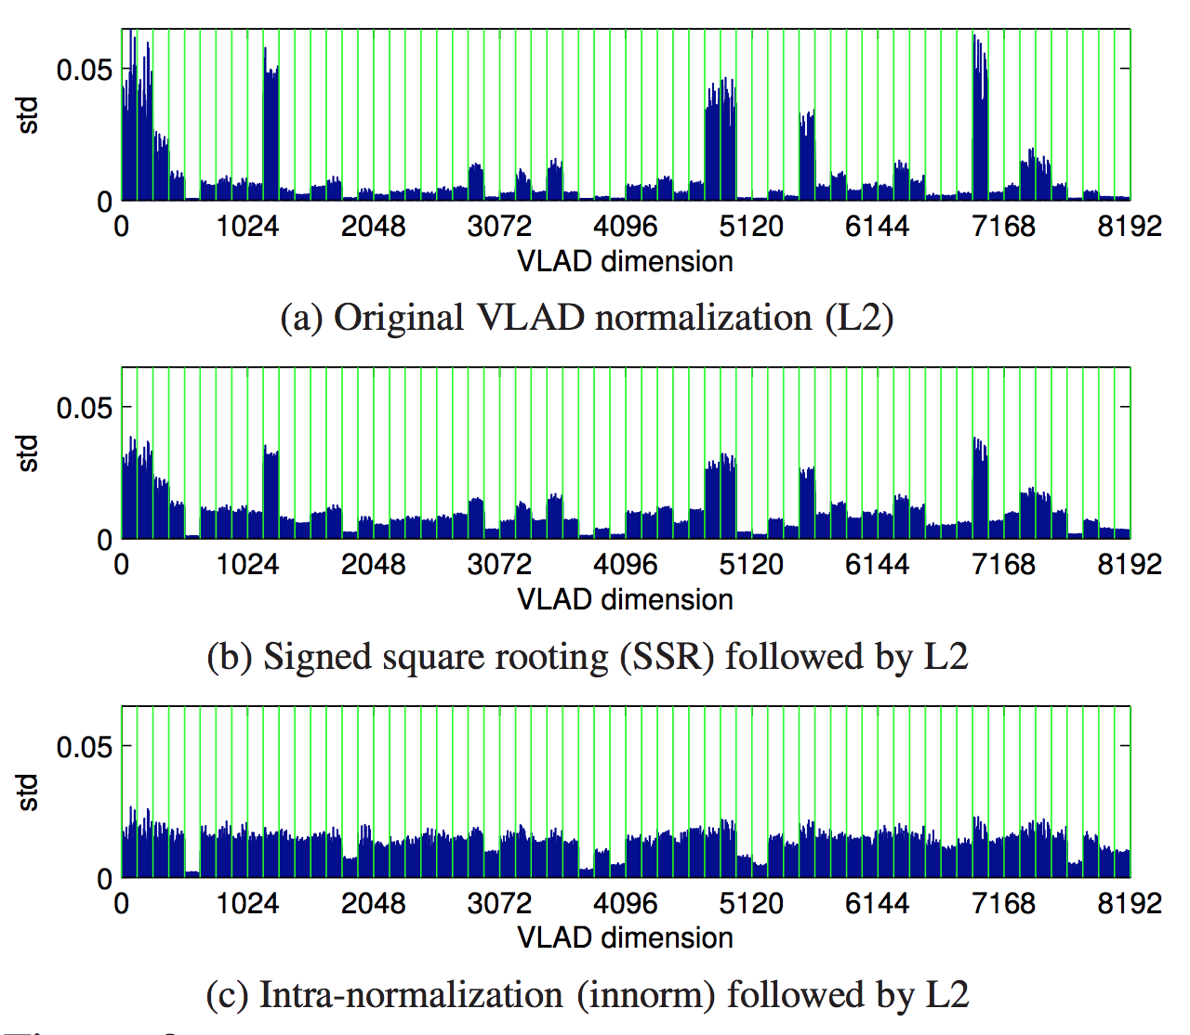
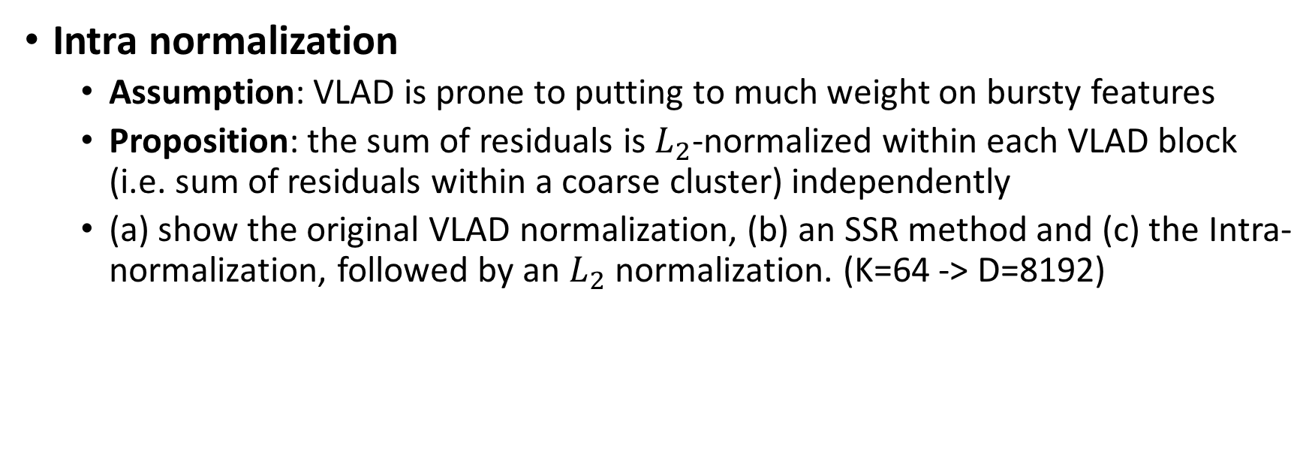
All about VLAD
Intra normalization
Assumption: VLAD is prone to putting to much weight on bursty features
Proposition: the sum of residuals is $L_{2}$-normalized within each VLAD block (i.e. sum of residuals within a coarse cluster) independently
(a) show the original VLAD normalization, (b) an SSR method and (c) the Intra-normalization, followed by an $L_{2}$ normalization. (K=64 -> D=8192)
Arandjelovic, Relja, and Andrew Zisserman. "All about VLAD." Proceedings of the IEEE conference on Computer Vision and Pattern Recognition. 2013

Slide 16
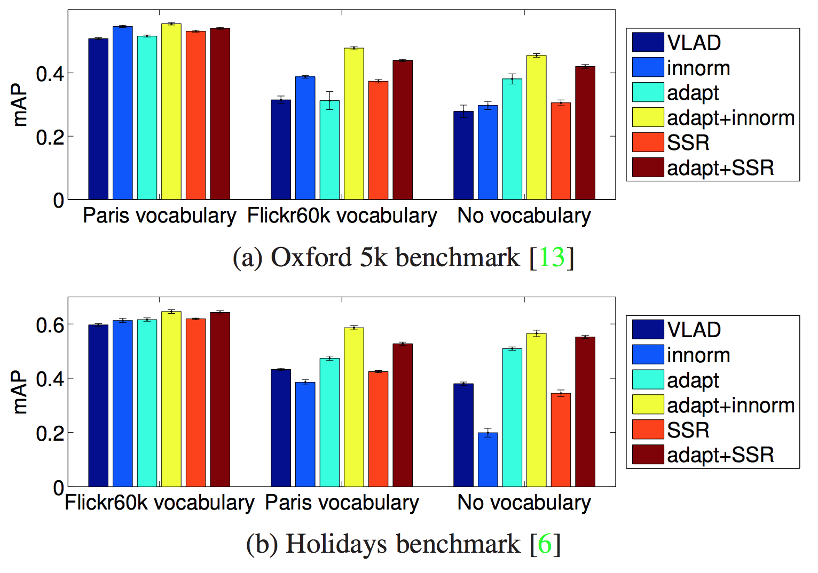
All about VLAD
Results:
2 Datasets
6 Methods
Original VLAD
Intra normalization
Vocabulary adaptation
Adaptation + Normalization
SSR
Adaptation + SSR
Arandjelovic, Relja, and Andrew Zisserman. "All about VLAD." Proceedings of the IEEE conference on Computer Vision and Pattern Recognition. 2013

Slide 17
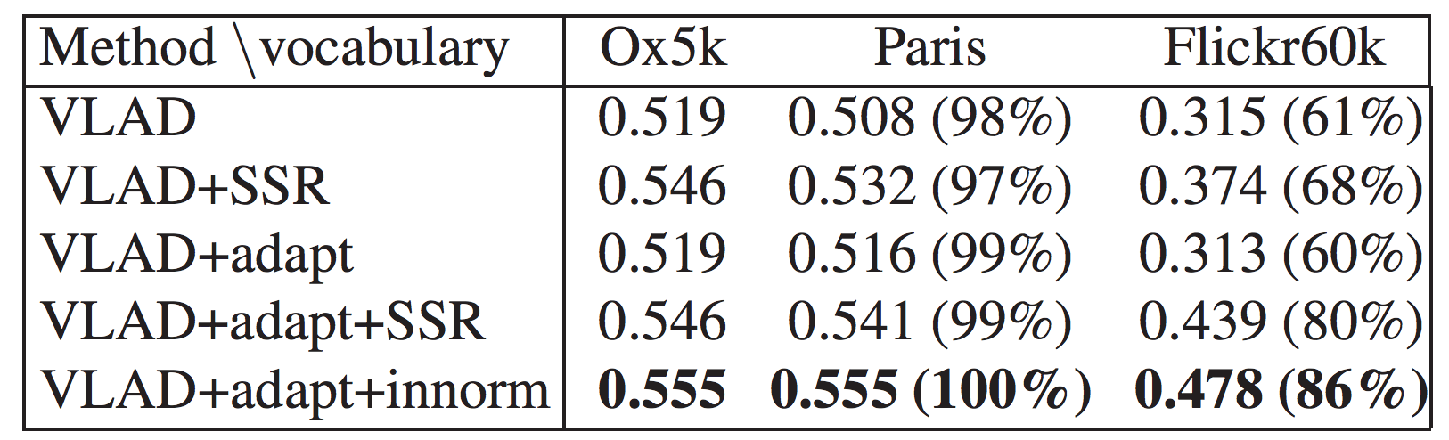
All about VLAD
Results:
Effect of the vocabulary adaptation
Initial vocabulary learned from Oxford5k / Tested on Paris and Flick60k
Arandjelovic, Relja, and Andrew Zisserman. "All about VLAD." Proceedings of the IEEE conference on Computer Vision and Pattern Recognition. 2013

Slide 18
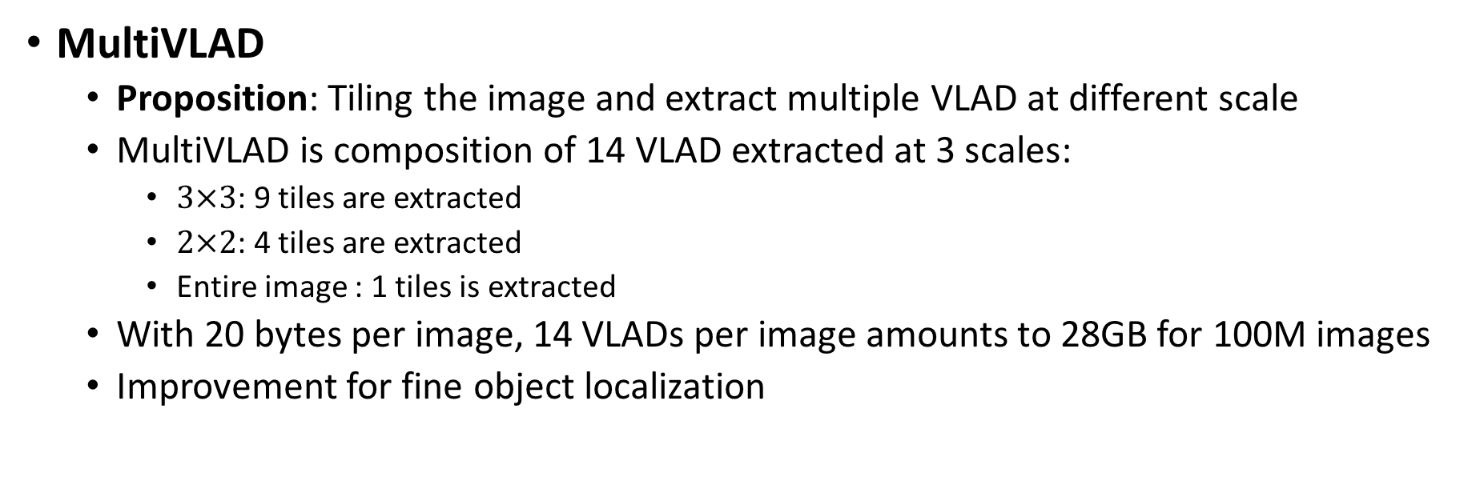
All about VLAD
MultiVLAD
Proposition: Tiling the image and extract multiple VLAD at different scale
MultiVLAD is composition of 14 VLAD extracted at 3 scales:
$3×3$: 9 tiles are extracted
$2×2$: 4 tiles are extracted
Entire image : 1 tiles is extracted
With 20 bytes per image, 14 VLADs per image amounts to 28GB for 100M images
Improvement for fine object localization
Arandjelovic, Relja, and Andrew Zisserman. "All about VLAD." Proceedings of the IEEE conference on Computer Vision and Pattern Recognition. 2013

Slide 19
Outline
Aggregating local descriptors into a compact image representation, Hervé Jégou, Matthijs Douze, Cordelia Schmid, and Patrick Pérez [CVPR10]
All about VLAD, Relja Arandjelovic, and Andrew Zisserman. [CVPR13]
NetVLAD: CNN architecture for weakly supervised place recognition, Relja Arandjelovic, Petr Gronat, Akihiko Torii, Tomas Pajdla, Josef Sivic [CVPR16]
ActionVLAD: Learning spatio-temporal aggregation for action classification, Rohit Girdhar, Deva Ramanan, Abhinav Gupta, Josef Sivic , Bryan Russell [CVPR17]
Learnable pooling with Context Gating for video classification. Antoine Miech, Ivan Laptev et Josef Sivic [YT8M17]

Slide 20
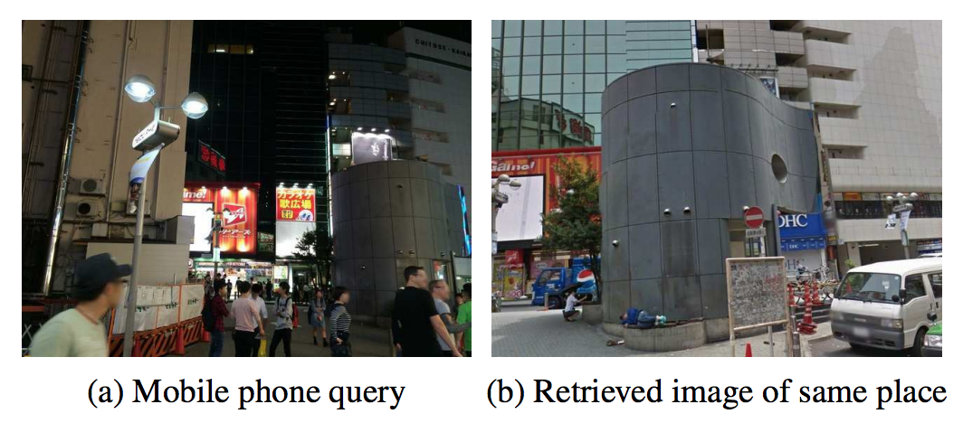
NetVLAD
Contribution:
Propose a CNN Architecture for weakly supervised place recognition
Design a trainable generalized VLAD layer
Make use of Google Street View Time Machine to collect large data
Noisy GPS and suffer occlusion: image can depict different part of the scene
Weak supervision
Make use of CNN features instead of SIFT: AlexNet and VGG-16 cropped at the last convolution layer (conv5).
Used as a pooling technique
Arandjelovic, Relja, et al. "NetVLAD: CNN architecture for weakly supervised place recognition." Proceedings of the IEEE Conference on Computer Vision and Pattern Recognition. 2016

Slide 21
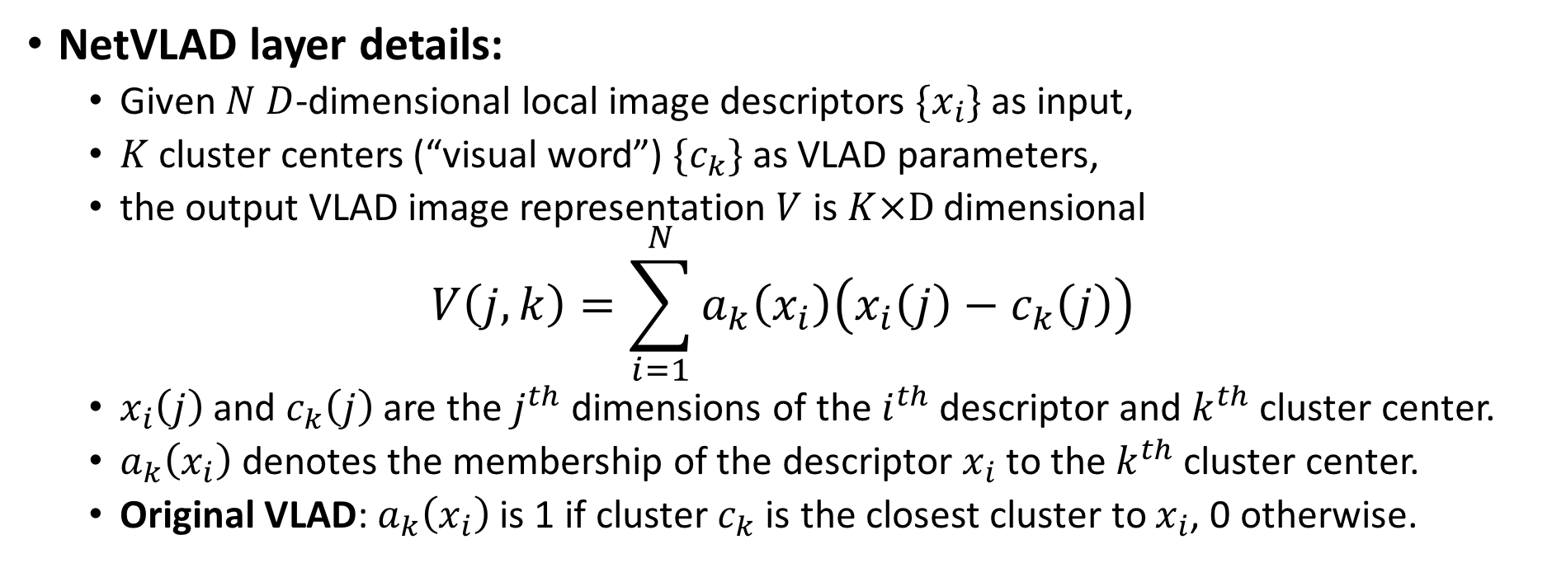
NetVLAD
NetVLAD layer details:
Given $N$ $D$-dimensional local image descriptors $\{x_{i}\}$ as input,
$K$ cluster centers (“visual word”) $\{c_{k}\}$ as VLAD parameters,
the output VLAD image representation $V$ is $K×D$ dimensional
$$V\left(j,k\right)=\sum_{i=1}^{N}{a_{k}\left(x_{i}\right)\left(x_{i}\left(j\right)−c_{k}\left(j\right)\right)}$$
$x_{i}\left(j\right)$ and $c_{k}\left(j\right)$ are the $j^{th}$ dimensions of the $i^{th}$ descriptor and $k^{th}$ cluster center.
$a_{k}\left(x_{i}\right)$ denotes the membership of the descriptor $x_{i}$ to the $k^{th}$ cluster center.
Original VLAD: $a_{k}\left(x_{i}\right)$ is 1 if cluster $c_{k}$ is the closest cluster to $x_{i}$, 0 otherwise.
Arandjelovic, Relja, et al. "NetVLAD: CNN architecture for weakly supervised place recognition." Proceedings of the IEEE Conference on Computer Vision and Pattern Recognition. 2016

Slide 22
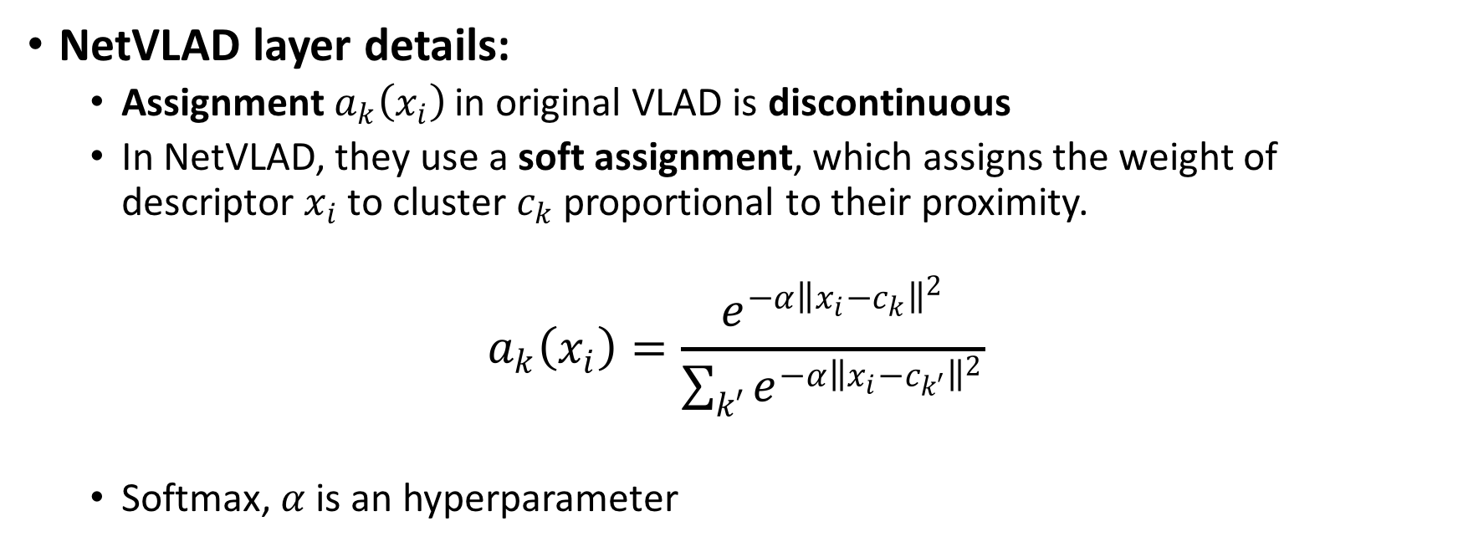
NetVLAD
NetVLAD layer details:
Assignment $a_{k}\left(x_{i}\right)$ in original VLAD is discontinuous
In NetVLAD, they use a soft assignment, which assigns the weight of descriptor $x_{i}$ to cluster $c_{k}$ proportional to their proximity.
$$a_{k}\left(x_{i}\right)=\frac{e^{−α{\left\|x_{i}−c_{k}\right\|}^{2}}}{\sum_{k′}{e^{−α{\left\|x_{i}−c_{k′}\right\|}^{2}}}}$$
Softmax, $α$ is an hyperparameter
Arandjelovic, Relja, et al. "NetVLAD: CNN architecture for weakly supervised place recognition." Proceedings of the IEEE Conference on Computer Vision and Pattern Recognition. 2016

Slide 23
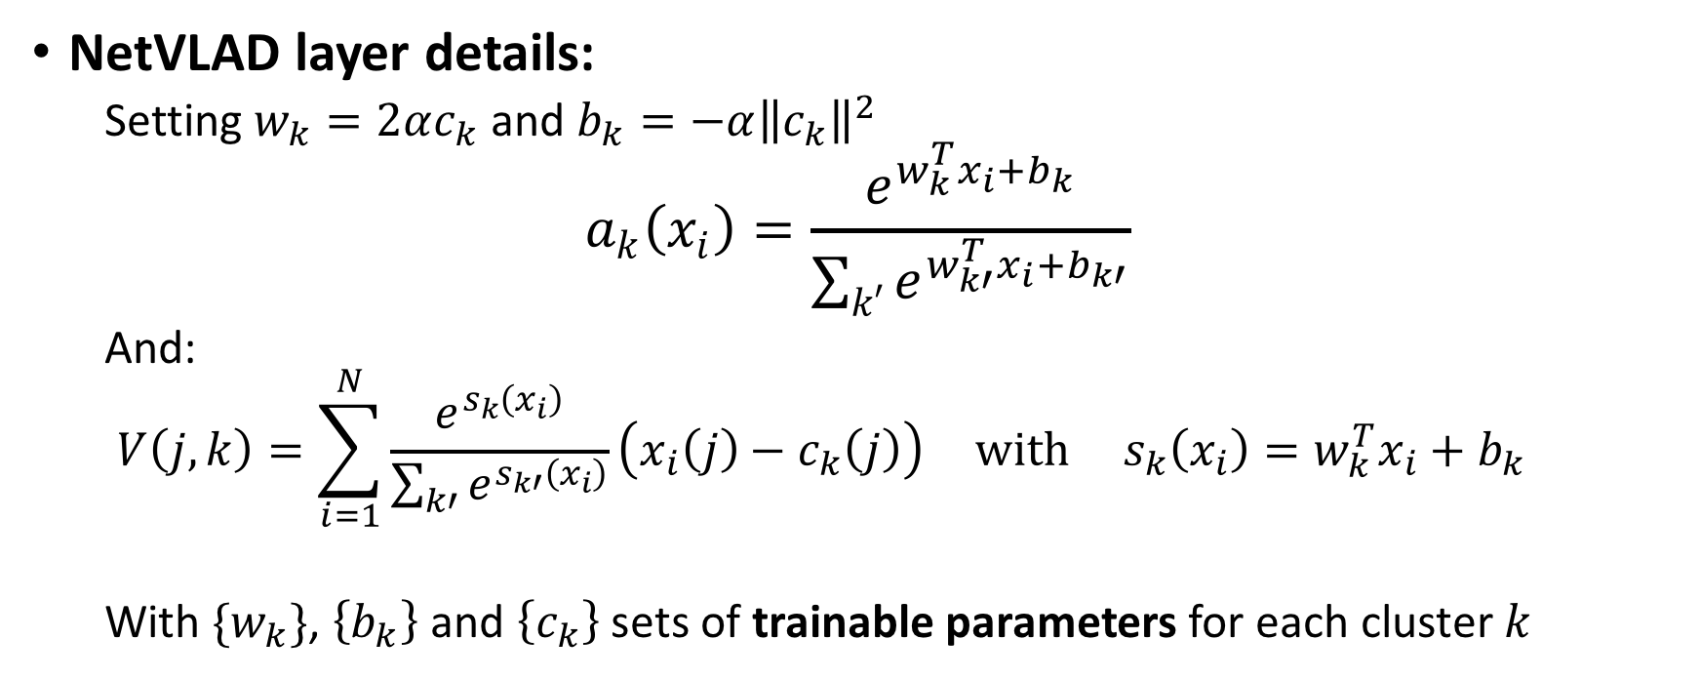
NetVLAD
NetVLAD layer details:
Setting $w_{k}=2αc_{k}$ and $b_{k}=−α{\left\|c_{k}\right\|}^{2}$
$$a_{k}\left(x_{i}\right)=\frac{e^{w_{k}^{T}x_{i}+b_{k}}}{\sum_{k′}{e^{w_{k′}^{T}x_{i}+b_{k′}}}}$$
And:
$$V\left(j,k\right)=\sum_{i=1}^{N}{\frac{e^{s_{k}\left(x_{i}\right)}}{\sum_{k′}{e^{s_{k′}\left(x_{i}\right)}}}\left(x_{i}\left(j\right)−c_{k}\left(j\right)\right)} with s_{k}\left(x_{i}\right)=w_{k}^{T}x_{i}+b_{k}$$
With $\{w_{k}\}$, $\left\{b_{k}\right\}$ and $\left\{c_{k}\right\}$ sets of trainable parameters for each cluster $k$
Arandjelovic, Relja, et al. "NetVLAD: CNN architecture for weakly supervised place recognition." Proceedings of the IEEE Conference on Computer Vision and Pattern Recognition. 2016

Slide 24
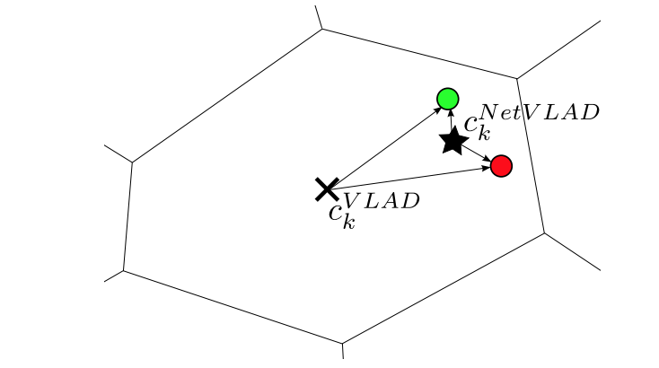
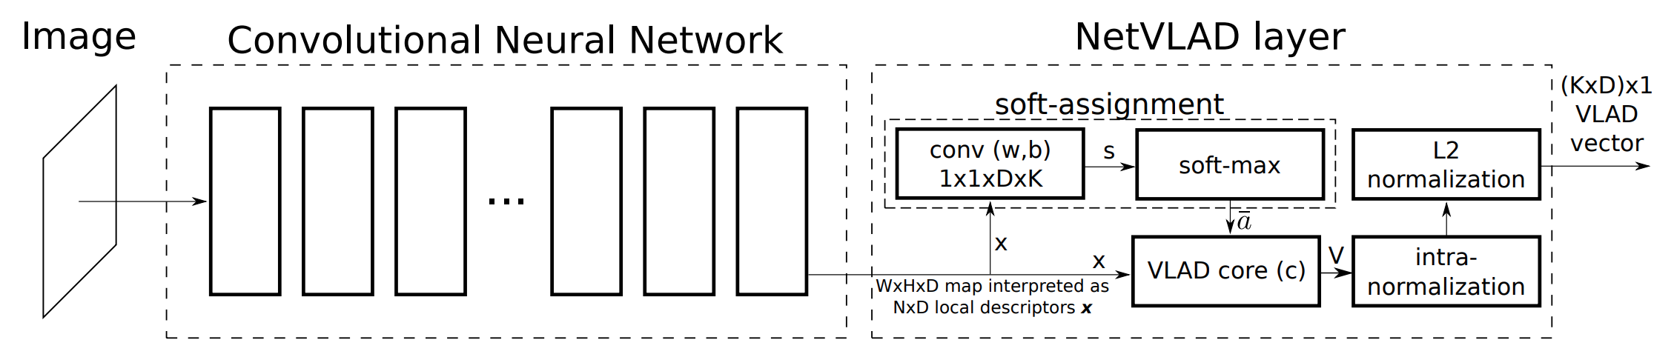
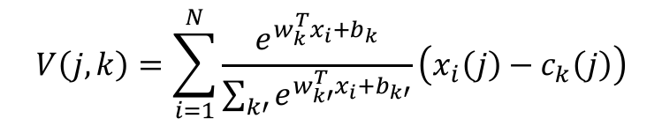
NetVLAD
NetVLAD network details:
$$V\left(j,k\right)=\sum_{i=1}^{N}{\frac{e^{w_{k}^{T}x_{i}+b_{k}}}{\sum_{k′}{e^{w_{k′}^{T}x_{i}+b_{k′}}}}\left(x_{i}\left(j\right)−c_{k}\left(j\right)\right)}$$
AlexNet or VGG-16 (after conv_5)
Arandjelovic, Relja, et al. "NetVLAD: CNN architecture for weakly supervised place recognition." Proceedings of the IEEE Conference on Computer Vision and Pattern Recognition. 2016

Slide 25
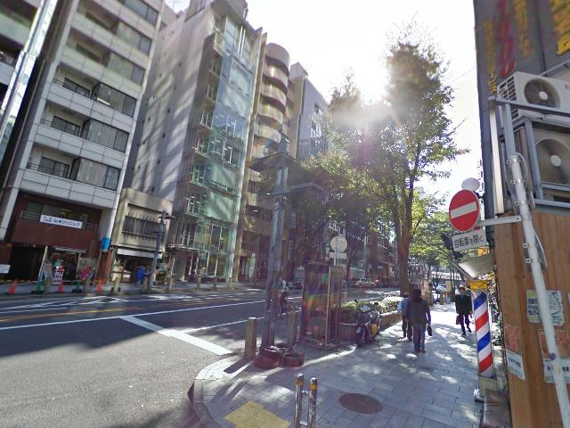
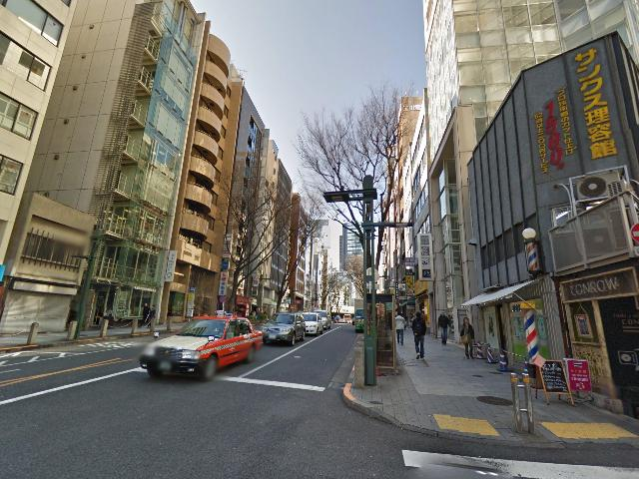
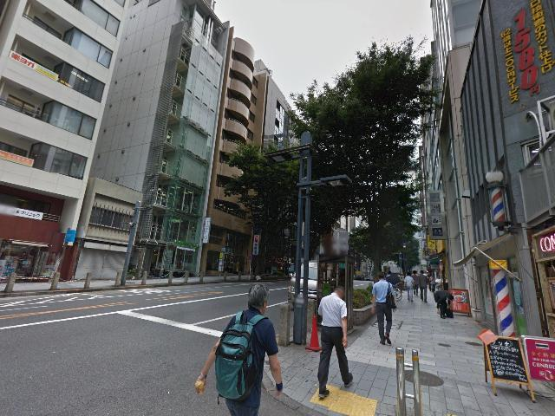
NetVLAD
Learning from Time Machine data:
Same locations at different times and seasons
Incomplete and noisy supervision (noisy GPS, wrong orientation, occlusion,…)
Arandjelovic, Relja, et al. "NetVLAD: CNN architecture for weakly supervised place recognition." Proceedings of the IEEE Conference on Computer Vision and Pattern Recognition. 2016

Slide 26
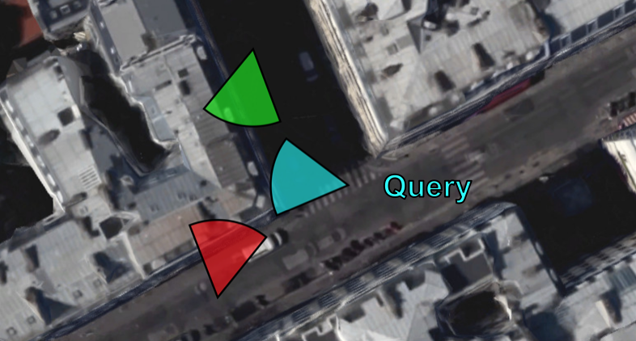
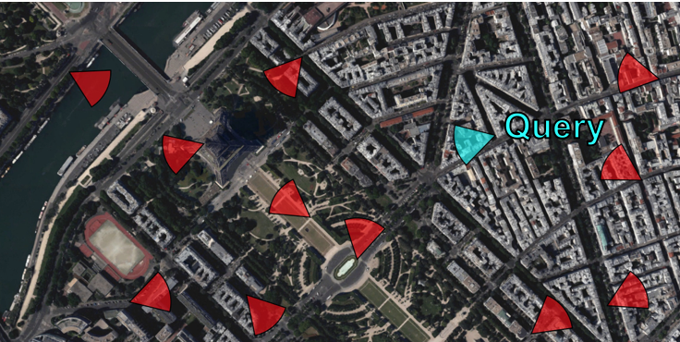
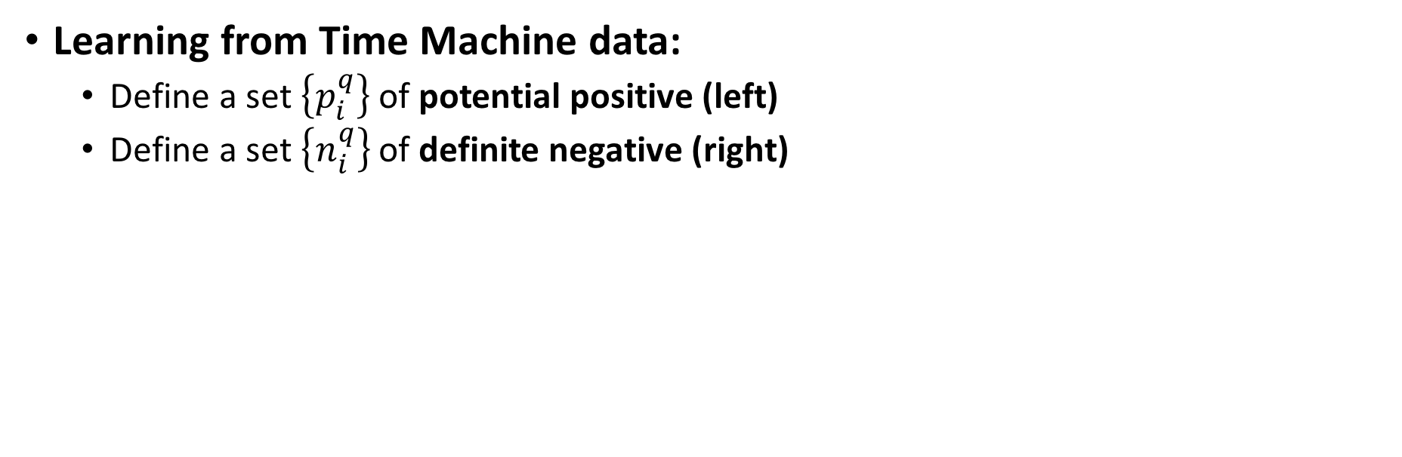
NetVLAD
Learning from Time Machine data:
Define a set $\left\{p_{i}^{q}\right\}$ of potential positive (left)
Define a set $\left\{n_{i}^{q}\right\}$ of definite negative (right)
Arandjelovic, Relja, et al. "NetVLAD: CNN architecture for weakly supervised place recognition." Proceedings of the IEEE Conference on Computer Vision and Pattern Recognition. 2016

Slide 27
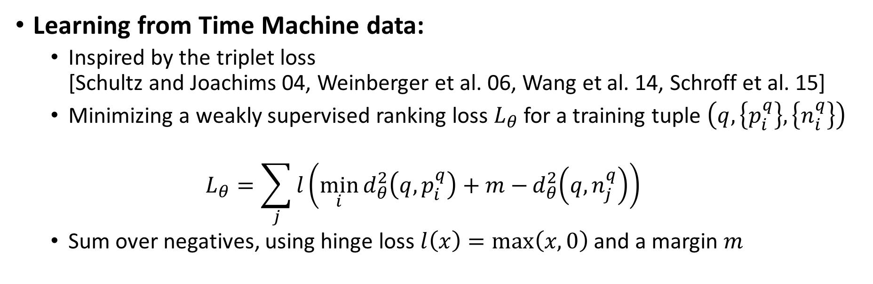
NetVLAD
Learning from Time Machine data:
Inspired by the triplet loss [Schultz and Joachims 04, Weinberger et al. 06, Wang et al. 14, Schroff et al. 15]
Minimizing a weakly supervised ranking loss $L_{θ}$ for a training tuple $\left(q,\left\{p_{i}^{q}\right\}, \left\{n_{i}^{q}\right\}\right)$
$$L_{θ}=\sum_{j}{l\left(\min_{i}{d_{θ}^{2}\left(q,p_{i}^{q}\right)+m−}d_{θ}^{2}\left(q,n_{j}^{q}\right)\right)}$$
Sum over negatives, using hinge loss $l\left(x\right)=\max\left(x,0\right)$ and a margin $m$
Arandjelovic, Relja, et al. "NetVLAD: CNN architecture for weakly supervised place recognition." Proceedings of the IEEE Conference on Computer Vision and Pattern Recognition. 2016

Slide 28
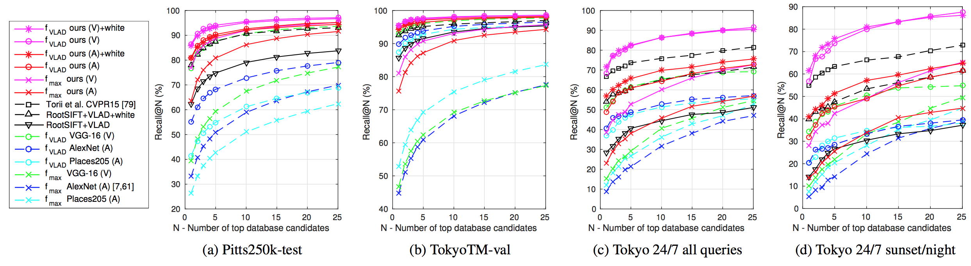
NetVLAD
Results: Comparison with state-of-the-art
Arandjelovic, Relja, et al. "NetVLAD: CNN architecture for weakly supervised place recognition." Proceedings of the IEEE Conference on Computer Vision and Pattern Recognition. 2016

Slide 29
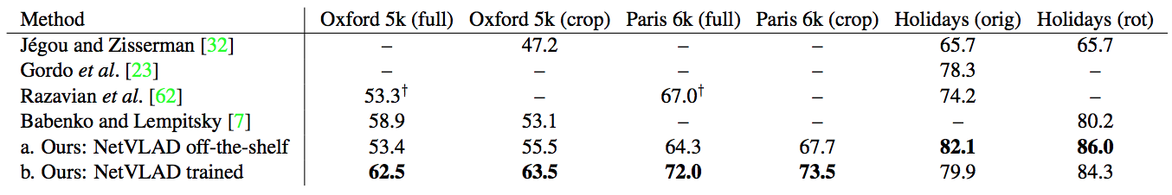
NetVLAD
Results: Comparison with state-of-the-art
Arandjelovic, Relja, et al. "NetVLAD: CNN architecture for weakly supervised place recognition." Proceedings of the IEEE Conference on Computer Vision and Pattern Recognition. 2016

Slide 30
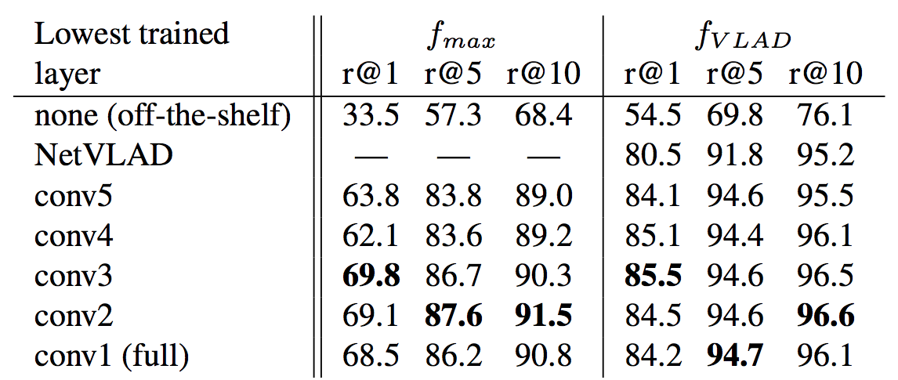
NetVLAD
Results:
Partial training
End-to-end
Back prop until:
NetVLAD
Conv5
Conv4
…
r@N is recall@N
Arandjelovic, Relja, et al. "NetVLAD: CNN architecture for weakly supervised place recognition." Proceedings of the IEEE Conference on Computer Vision and Pattern Recognition. 2016

Slide 31
Outline
Aggregating local descriptors into a compact image representation, Hervé Jégou, Matthijs Douze, Cordelia Schmid, and Patrick Pérez [CVPR10]
All about VLAD, Relja Arandjelovic, and Andrew Zisserman. [CVPR13]
NetVLAD: CNN architecture for weakly supervised place recognition, Relja Arandjelovic, Petr Gronat, Akihiko Torii, Tomas Pajdla, Josef Sivic [CVPR16]
ActionVLAD: Learning spatio-temporal aggregation for action classification, Rohit Girdhar, Deva Ramanan, Abhinav Gupta, Josef Sivic , Bryan Russell [CVPR17]
Learnable pooling with Context Gating for video classification. Antoine Miech, Ivan Laptev et Josef Sivic [YT8M17]

Slide 32
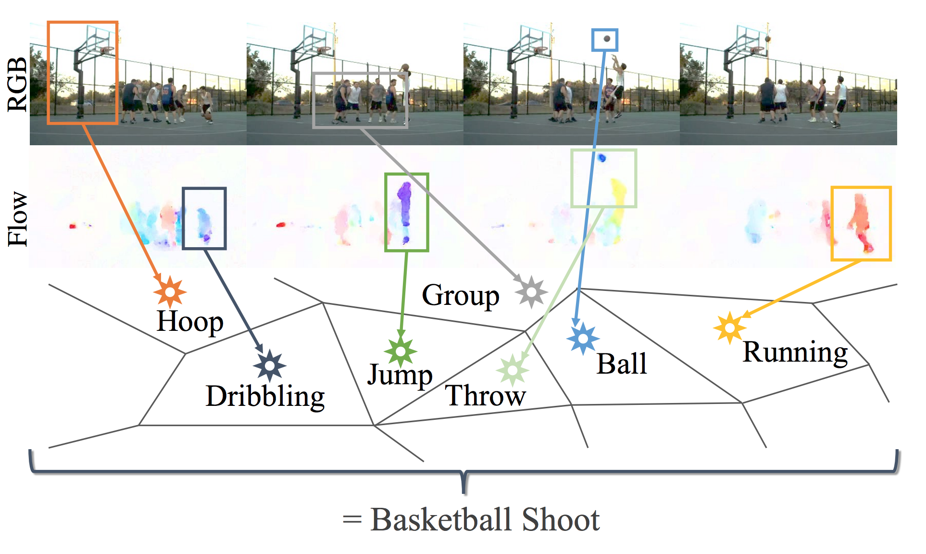
ActionVLAD
How do we represent actions in video?
Spatio-temporal aggregation of a set of primitives over the appearance and motion streams
Instead of max or average pooling, ActionVLAD cluster action features
Girdhar, Rohit, et al. "ActionVLAD: Learning spatio-temporal aggregation for action classification." arXiv preprint arXiv:1704.02895 (2017)

Slide 33
ActionVLAD
Learning spatiotemporal aggregation for action classification
Application of VLAD pooling technique on video classification
Make use of Two Stream method to extract per frame features
End-to-End trainable pipeline.
It is important to pool jointly across space and time
Appearance and motion streams are best aggregated into their own representations
Outperform state-of-the-art
Girdhar, Rohit, et al. "ActionVLAD: Learning spatio-temporal aggregation for action classification." arXiv preprint arXiv:1704.02895 (2017)

Slide 34
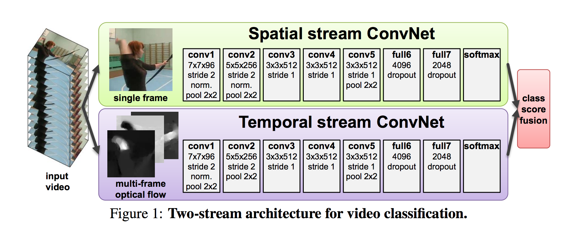
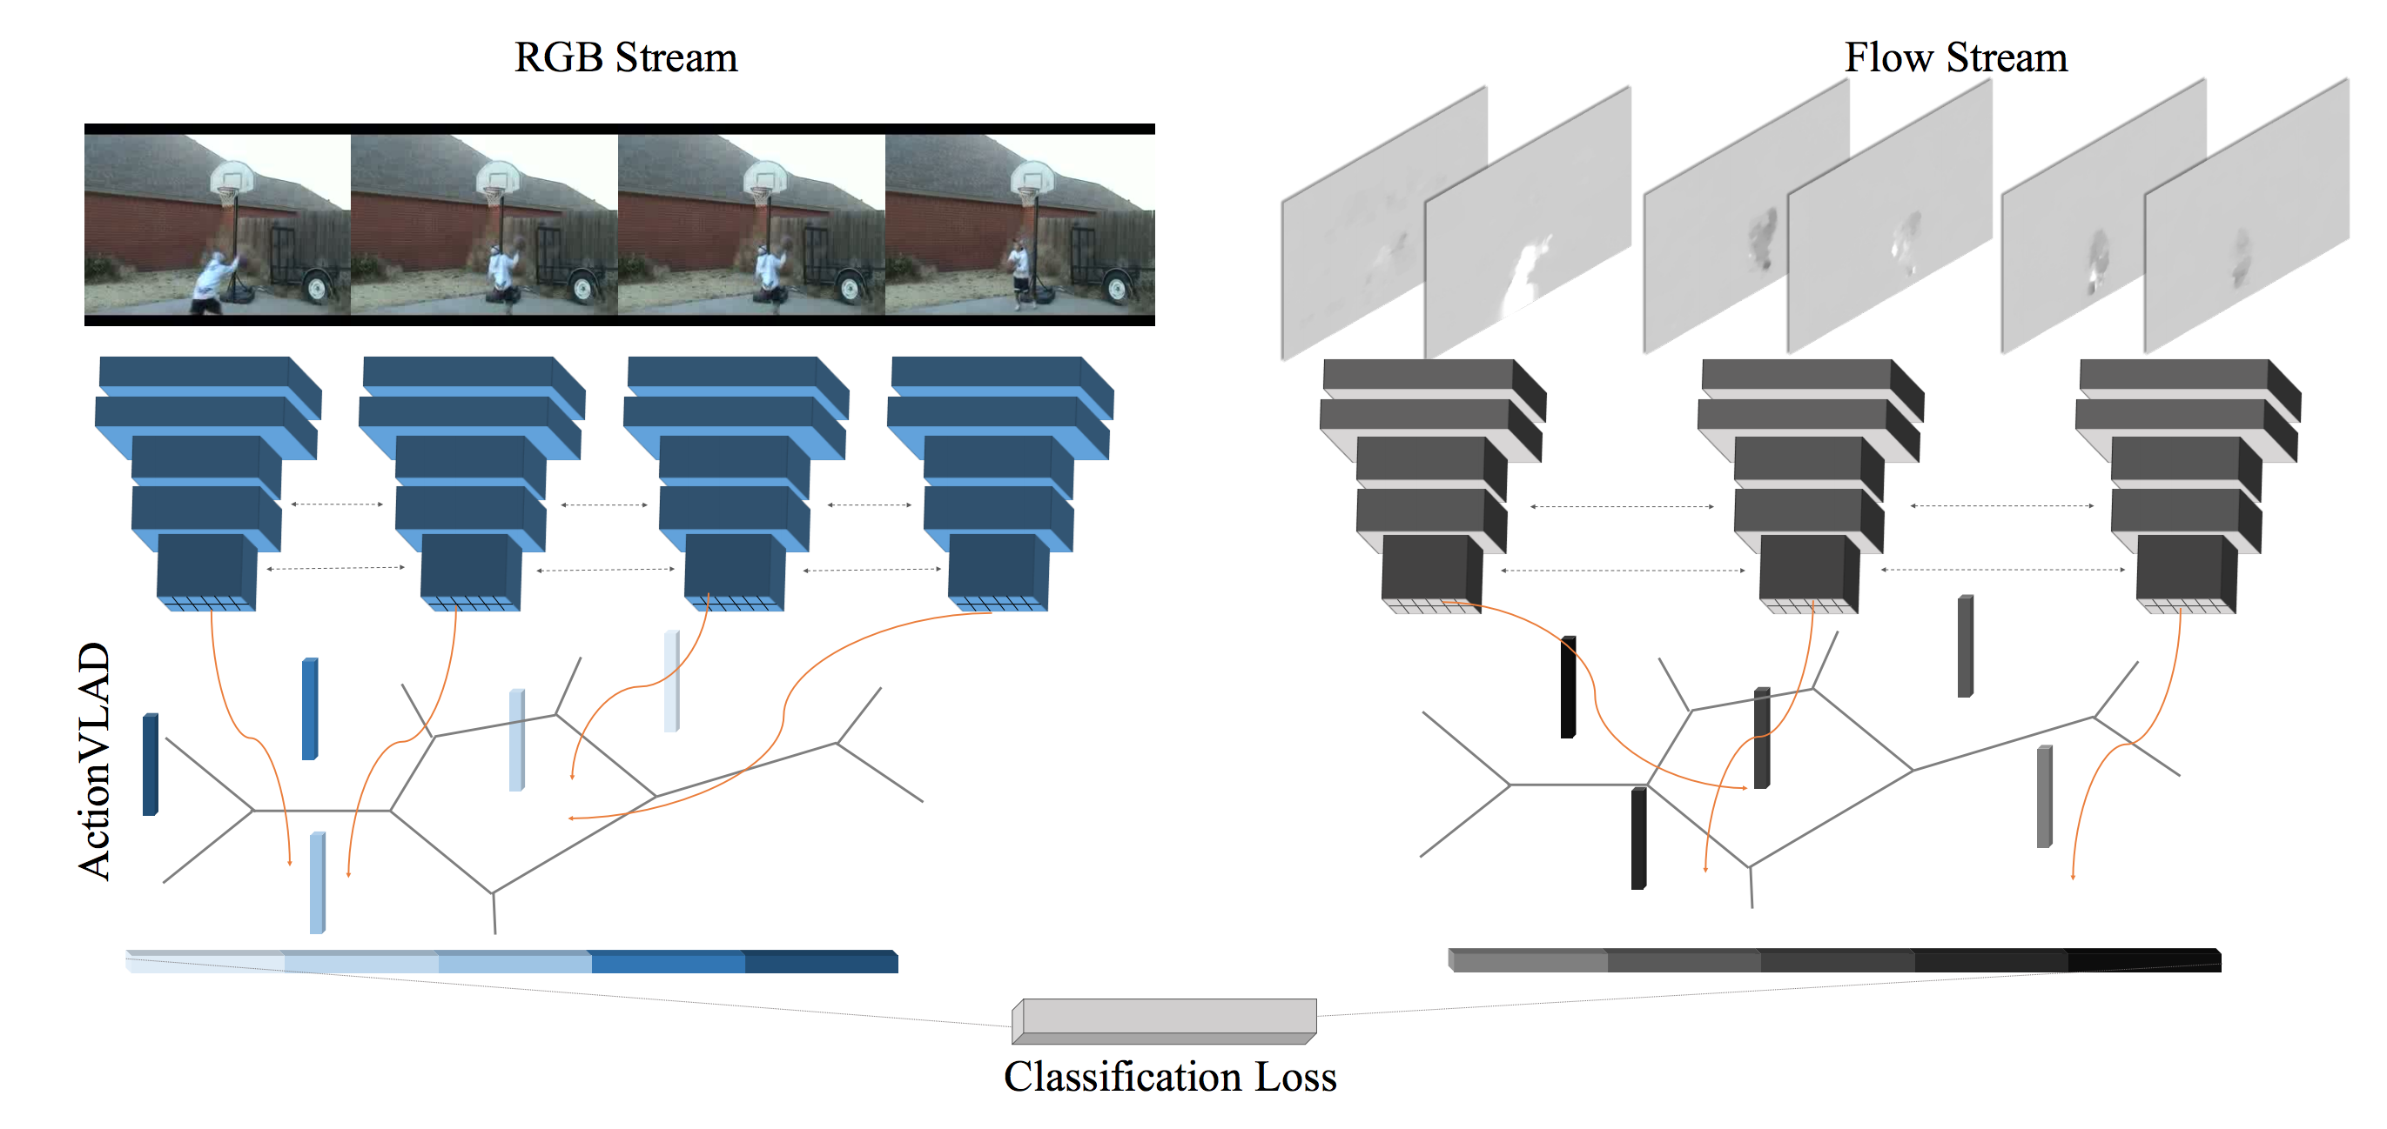
ActionVLAD
Two-Stream Method [Simonyan et al., 2014] + NetVLAD
Girdhar, Rohit, et al. "ActionVLAD: Learning spatio-temporal aggregation for action classification." arXiv preprint arXiv:1704.02895 (2017)

Slide 35
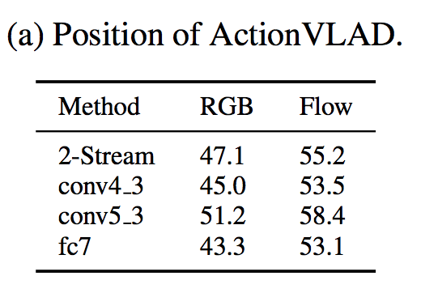
ActionVLAD
Which layer to aggregate?
After TwoStream: 4096 length vector
fc7: 2048 length vector
conv5_3: 196 (14x14) 512-dimensional vectors
conv4_3: 786 (28x28) 512-dimensional vectors
Best results shown on conv5_3
Girdhar, Rohit, et al. "ActionVLAD: Learning spatio-temporal aggregation for action classification." arXiv preprint arXiv:1704.02895 (2017)

Slide 36
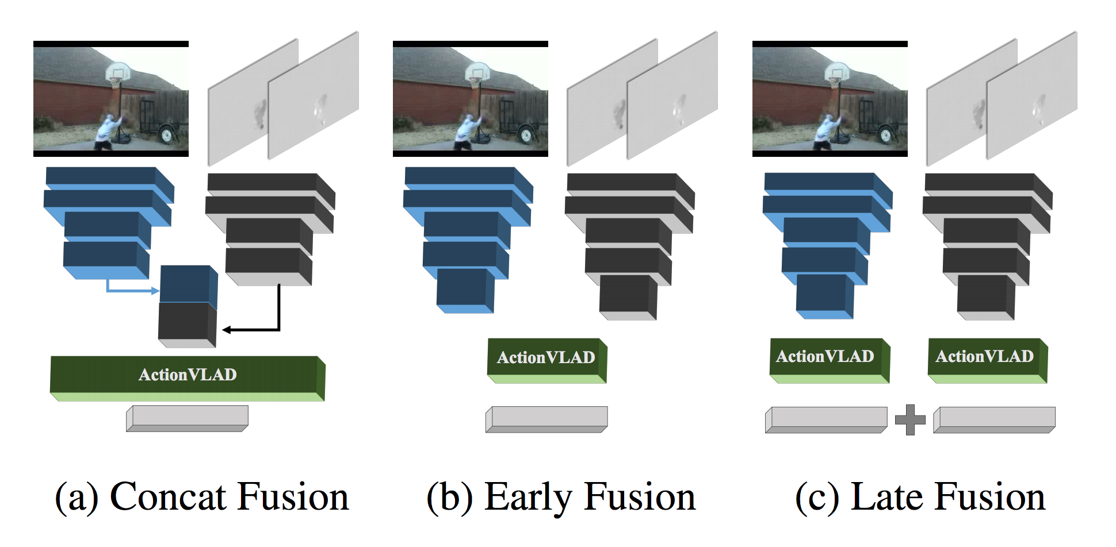
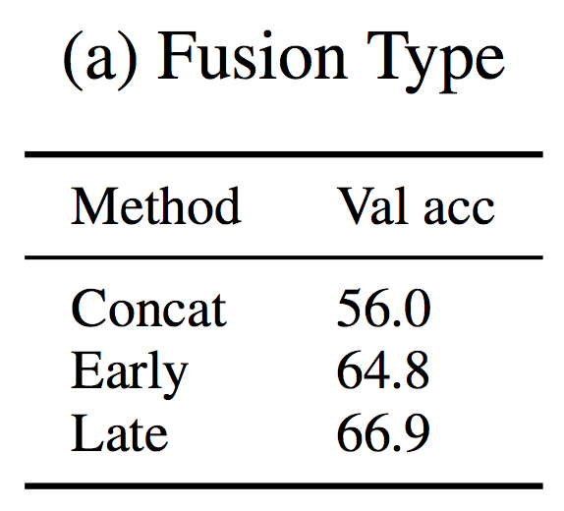
ActionVLAD
How to combine flow and RGB streams?
Concatenate along D
Stack along N
Concatenated output
Better at the end
Girdhar, Rohit, et al. "ActionVLAD: Learning spatio-temporal aggregation for action classification." arXiv preprint arXiv:1704.02895 (2017)

Slide 37
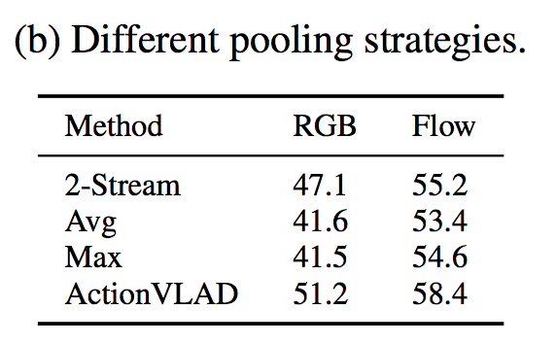
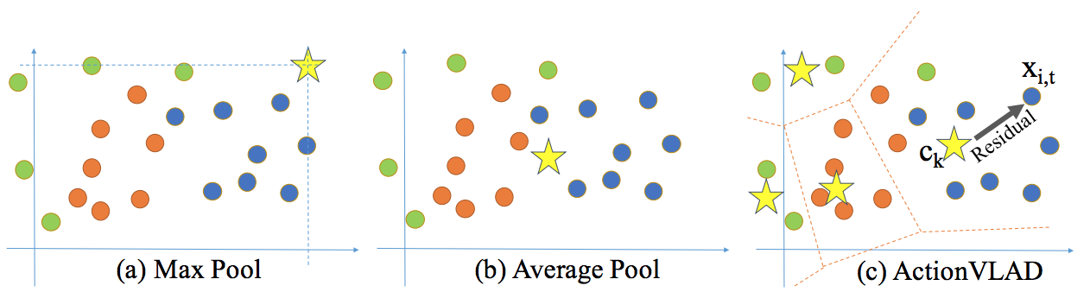
ActionVLAD
How performant is the pooling?
Outperform Max and Average pooling
Girdhar, Rohit, et al. "ActionVLAD: Learning spatio-temporal aggregation for action classification." arXiv preprint arXiv:1704.02895 (2017)

Slide 38
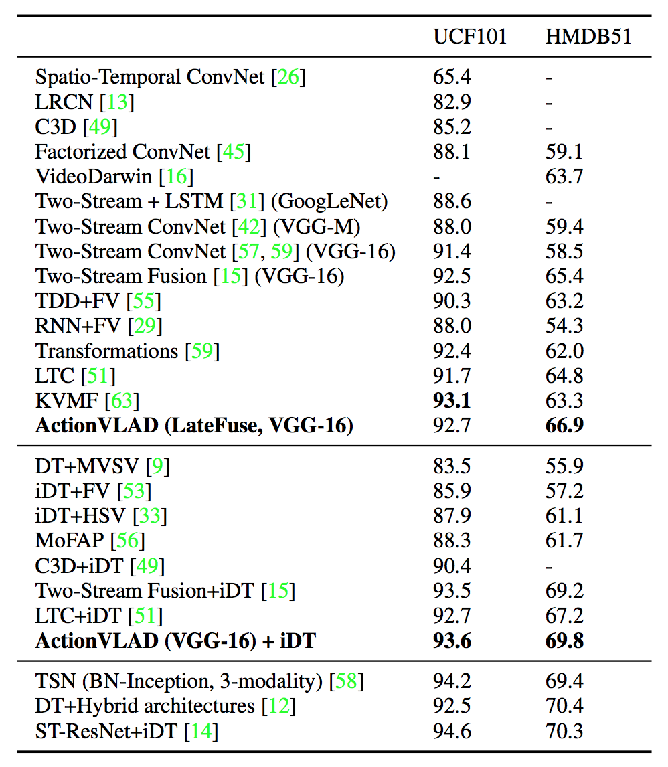
ActionVLAD
Outperform the state-of-the-art
Video:
https://www.youtube.com/watch?v=wVde6BPVUM0
Girdhar, Rohit, et al. "ActionVLAD: Learning spatio-temporal aggregation for action classification." arXiv preprint arXiv:1704.02895 (2017)

Slide 39
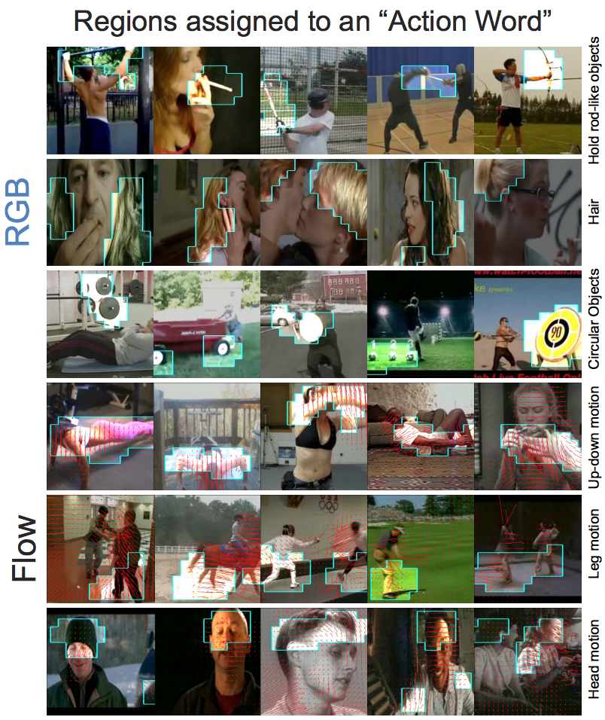
ActionVLAD
Visualization: Regions assigned to “Action Word”
https://www.youtube.com/watch?v=wVde6BPVUM0
Girdhar, Rohit, et al. "ActionVLAD: Learning spatio-temporal aggregation for action classification." arXiv preprint arXiv:1704.02895 (2017)

Slide 40
Outline
Aggregating local descriptors into a compact image representation, Hervé Jégou, Matthijs Douze, Cordelia Schmid, and Patrick Pérez [CVPR10]
All about VLAD, Relja Arandjelovic, and Andrew Zisserman. [CVPR13]
NetVLAD: CNN architecture for weakly supervised place recognition, Relja Arandjelovic, Petr Gronat, Akihiko Torii, Tomas Pajdla, Josef Sivic [CVPR16]
ActionVLAD: Learning spatio-temporal aggregation for action classification, Rohit Girdhar, Deva Ramanan, Abhinav Gupta, Josef Sivic , Bryan Russell [CVPR17]
Learnable pooling with Context Gating for video classification. Antoine Miech, Ivan Laptev et Josef Sivic [YT8M17]

Slide 41
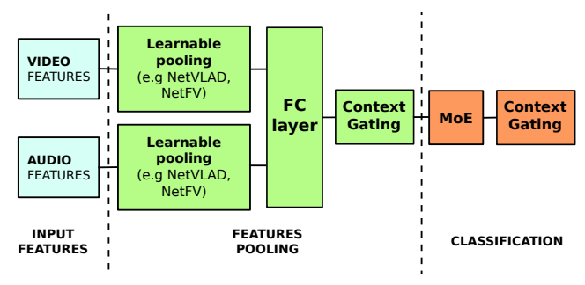
Learnable pooling with Context Gating
Winner of the YouTube-8M Challenge
Miech, Antoine, Ivan Laptev, and Josef Sivic. "Learnable pooling with Context Gating for video classification." arXiv preprint arXiv:1706.06905 (2017)

Slide 42
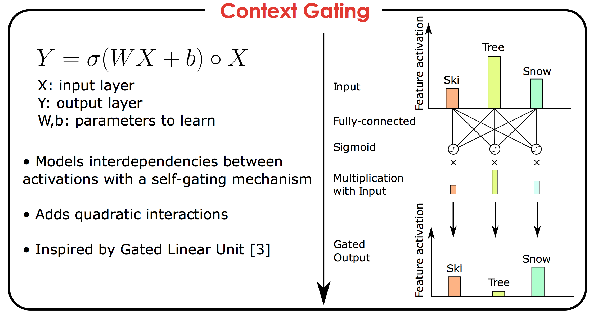
Learnable pooling with Context Gating
Miech, Antoine, Ivan Laptev, and Josef Sivic. "Learnable pooling with Context Gating for video classification." arXiv preprint arXiv:1706.06905 (2017)

Slide 43
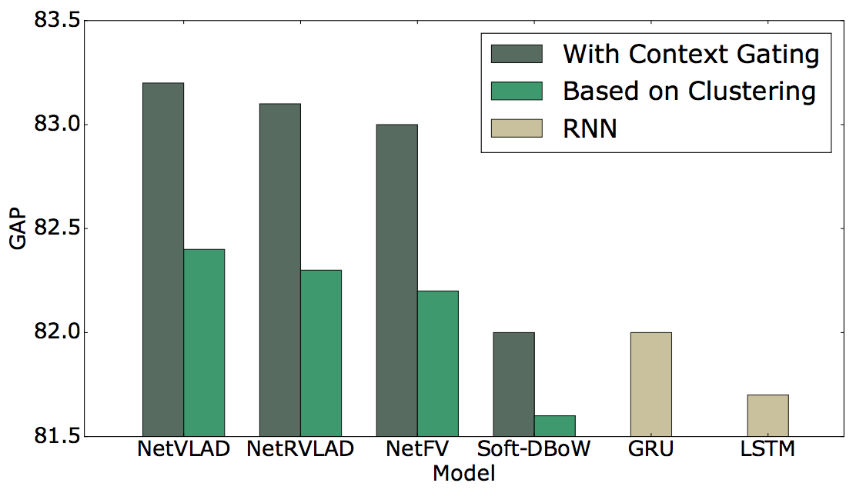
Learnable pooling with Context Gating
Miech, Antoine, Ivan Laptev, and Josef Sivic. "Learnable pooling with Context Gating for video classification." arXiv preprint arXiv:1706.06905 (2017)

Slide 44
Learning how to pool features Vector of Locally Aggregated Descriptors (VLAD)
Silvio Giancola
Thursday, October 12th 2017

